Slide 1
My journey to Aotearoa

Slide 2
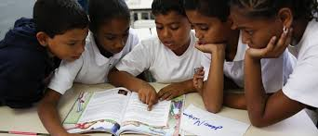
Why people move to different countries?
People move for good education.
To be safe in this country.
To explore more about a different country.
And to be smarter.
Some people move into different countries.
.

Slide 3
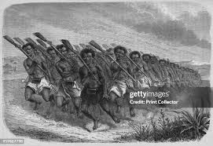
Why New Zealand
people come to New Zealand to escape from war.
to be safe in our country.
to make a country a better place for them and their family.
to fight for our country.
to fight for a country.

Slide 4
Why did my family come to New Zealand.
I was born in New Zealand then my nana came from Cook Islands.
because it is better here.
and to make a better life.
to make a easier.
and Jamaica happy life.

Slide 5
thank you for listening to my journey.

